Slide 1
7. [Lab4] REST API
Training Workshop for IONIC framework

Slide 2
Objectives
Understand what REST API is.
Learn how to create API using Node.js, Express.js, and mongoDB.
Learn how to implement CRUD operation using museum API created in chapter5 Lab2.
Learn how to test API.

Slide 3
Contents
7.1 Introducing REST API
7.1.1 What is REST API?
7.1.2 Guide for designing REST API
7.2 Creating REST API
7.2.1 Implementing example API
7.3 Testing API

Slide 4
7.1 Introducing REST API
7.1.1 What is REST API?
REST stands for Representational State Transfer.
REST is a web standard based architecture that uses HTTP protocol
There are 6 distinct advantages of REST
Scalability
Use of HTTP
Independency
Reduced latency due to caching
Security
Encapsulation

Slide 5
7.1 Introducing REST API
7.1.1 What is REST API?
REST API
REST API refers to web API based on REST architecture
REST API consists of “Resource(URI)”, “Verb(HTTP METHOD)” and representations.
Features
Uniform interface
Stateless
Self-descriptiveness

Slide 6
7.1 Introducing REST API
7.1.2 Guide for designing RESTful API
A URI must represent a resource of information.
The action on the resource is expressed by HTTP Method (GET, POST, PUT, DELETE).
Http methods for CRUD operations
Create – POST, Read – GET, Update – PUT, Delete - DELETE
Rule
A URI must represent a resource of information. (Resource names use nouns rather than verbs)

Slide 7
7.1 Introducing REST API
7.1.2 Guide for designing RESTful API
HTTP methods for CRUD operations
APIs for data access and management are typically concerned with four actions.
Create – It is the ability to create a resource. It maps to POST methods.
Read – It is the ability to retrieve a resource. It maps to GET methods.
Update – It is the ability to modify a resource. It maps to PUT methods.
Delete – It is the ability to remove a resource. It maps to DELETE methods.

Slide 8
7.1 Introducing REST API
7.1.2 Guide for designing RESTful API
GET
The HTTP GET method is used to provide a read-only access to a resource
They can be called without risk of data modification or corruption
GET is idempotent, which means that making multiple identical requests ends up having the same result as a single request.

Slide 9
7.1 Introducing REST API
7.1.2 Guide for designing RESTful API
PUT
This is used to update an existing resource or create a new resource
DELETE
This is used to remove a resource identified by a URL

Slide 10
7.1 Introducing REST API
7.1.2 Guide for designing RESTful API
POST
This is used to update a new resource
POST is neither safe nor idempotent
Making two identical POST requests will most-likely result in two resources containing the same information

Slide 11
7.2 Creating REST API
Following steps show how to implement REST API using museum API.
In Lab2, we created museum API for read operation. In this section, we also implement create, update, and delete operation.
Open the server project that we used.
C:\desktop\server\example
Go to routes/museum.js file.
To use mongojs, add following codes into museum.js
Name of database
Collection
museum.js

Slide 12
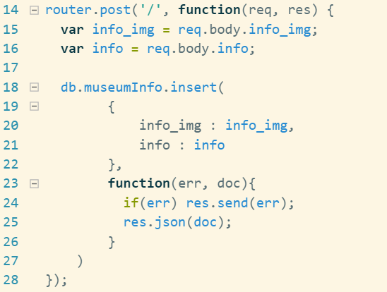
7.2 Creating REST API
Following steps show how to implement REST API using museum API.
Implement insert function by using POST method.
museum.js

Slide 13
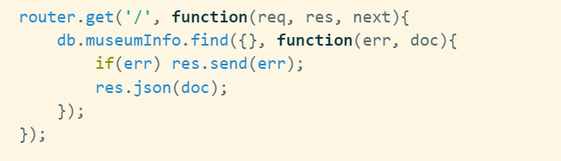
7.2 Creating REST API
Following steps show how to implement REST API using museum API.
Implement read function by using GET method.
Response is in json format.
museum.js

Slide 14
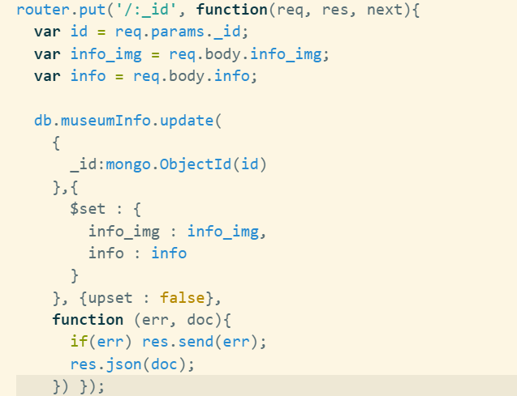
7.2 Creating REST API
Following steps show how to implement REST API using museum API.
Implement update function by using PUT method.
museum.js

Slide 15
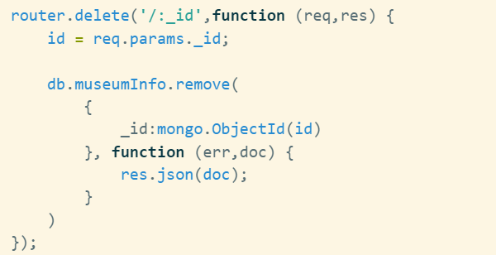
7.2 Creating REST API
Following steps show how to implement REST API using museum API.
Implement delete function by using DELETE method.
museum.js

Slide 16
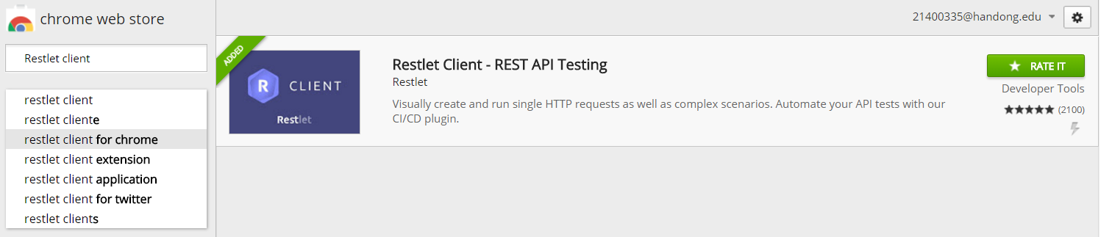
7.3 Testing API
Test API by using Restlet Client program.
Restlet Client program will be used for testing API.
Go to chrome web store.
Add Restlet client.

Slide 17

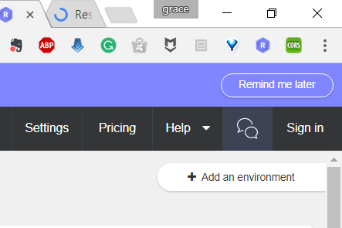
7.3 Testing API
Test API by using Restlet Client program.
After adding Restlet client, click the icon and sign in.

Slide 18
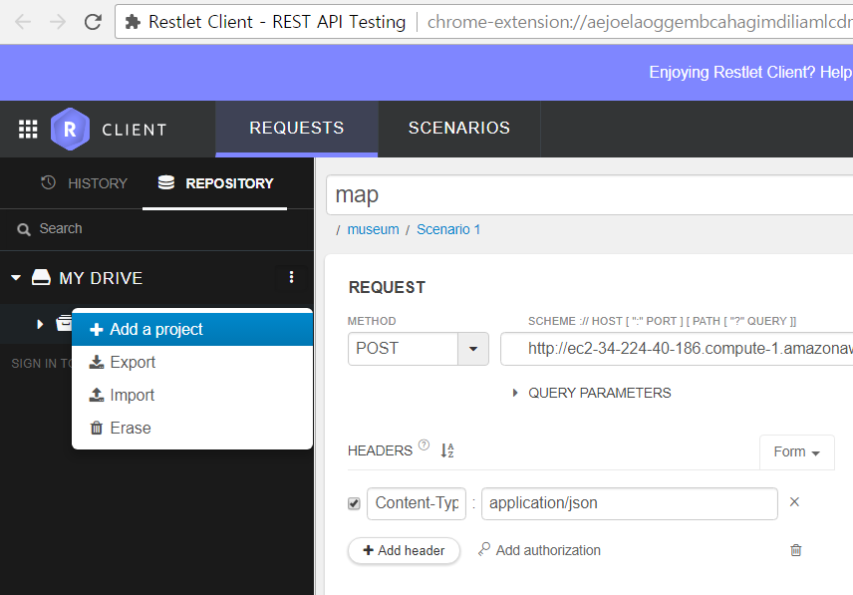
7.3 Testing API
Test API by using Restlet Client program.
Add project museum.

Slide 19
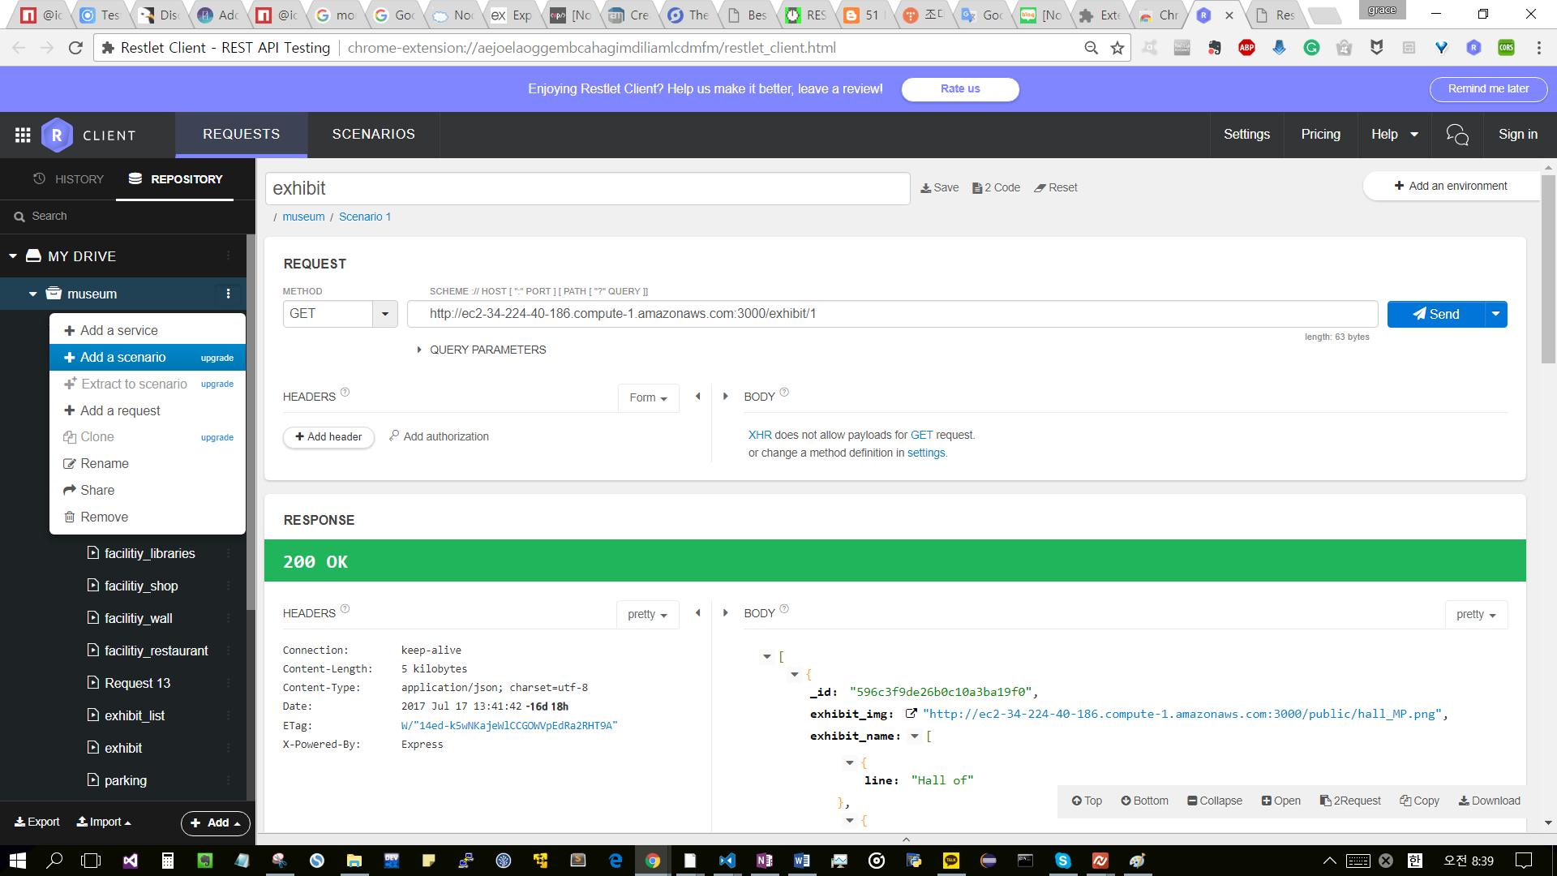
7.3 Testing API
Test API by using Restlet Client program.
Add scenario to museum.

Slide 20
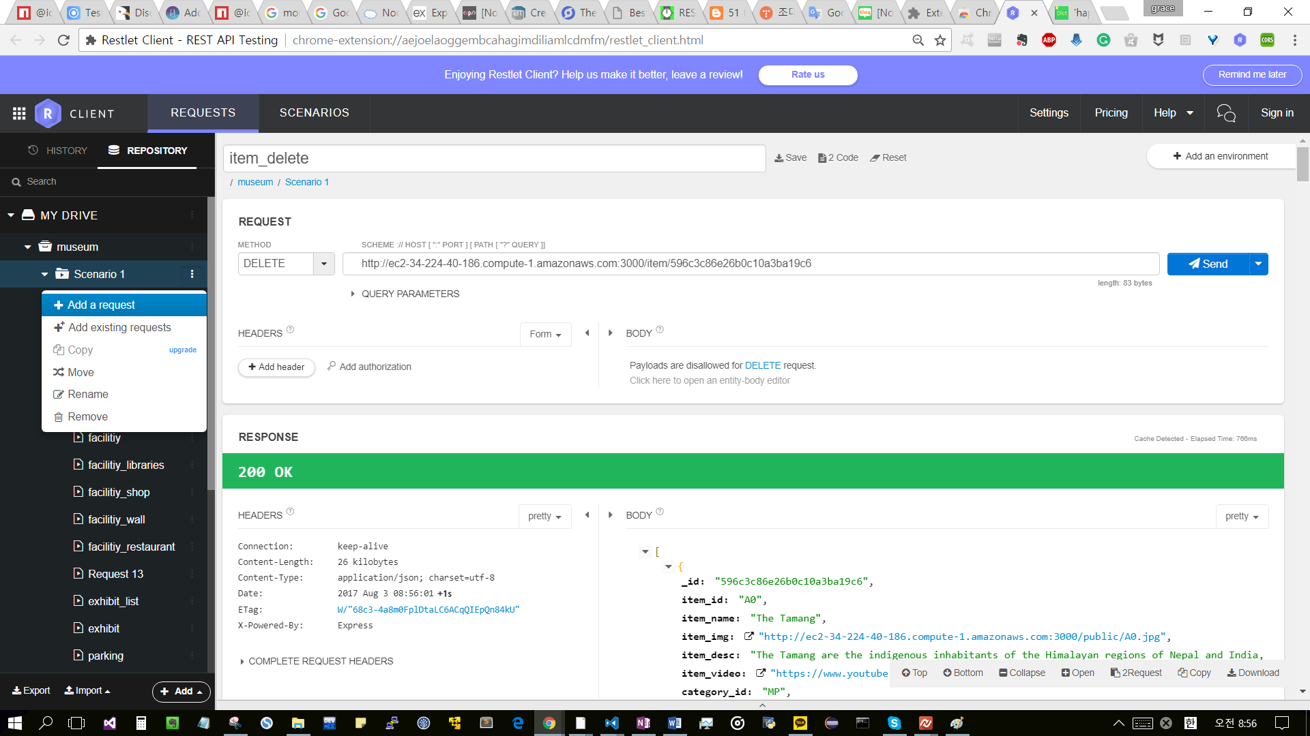
7.3 Testing API
Test API by using Restlet Client program.
Add request to scenario.

Slide 21
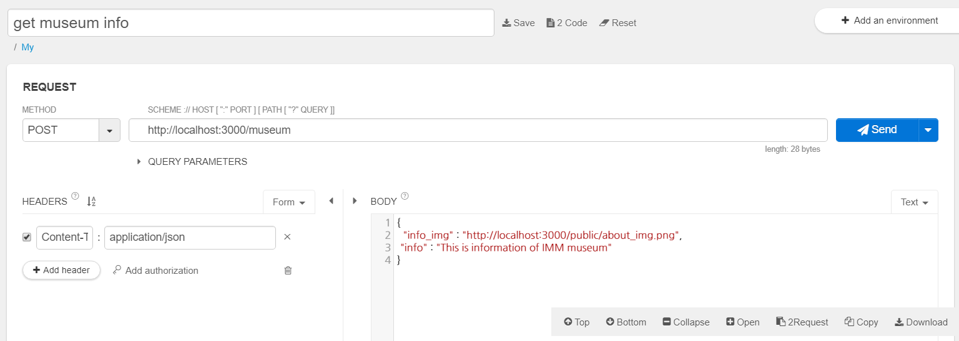
7.3 Testing API
Test API by using Restlet Client program.
To check that POST is working, write request as following.

Slide 22
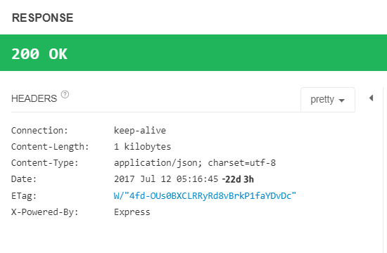
7.3 Testing API
Test API by using Restlet Client program.
Send the request and you can get successful response.

Slide 23
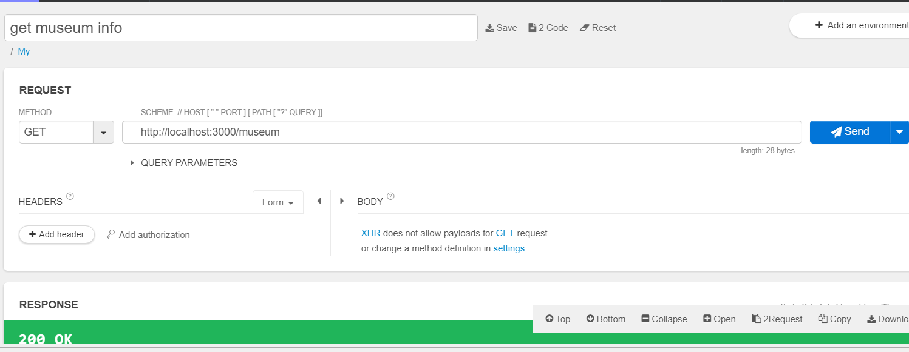
7.3 Testing API
Test API by using Restlet Client program.
To read data from database, write GET method request.

Slide 24
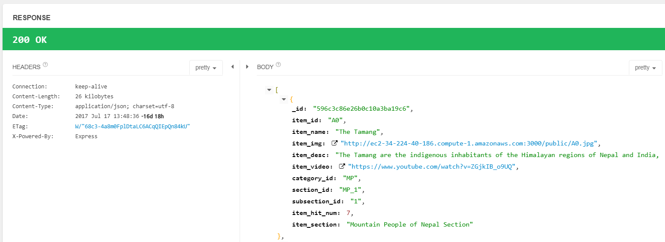
7.3 Testing API
Test API by using Restlet Client program.
The data inserted in previous step will be shown.

Slide 25
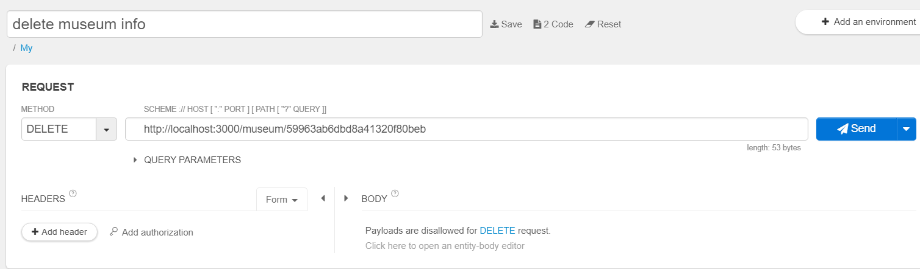
7.3 Testing API
Test API by using Restlet Client program.
To delete data from database, use DELETE request using _id.

Slide 26
Summary
We learn about REST API and good API design.
We modified museum API for create, read, update and delete operation.
We tested API using Restlet client program.

Slide 27






Summary
Request
URI: http://localhost:3000/museum
REST API
(MongoDB)
Response
app.js
app.use
museum.js
{
info_img: http://localhost:30 00/public/...
“info:…”
}
Request URI (HTTP)
Response URI (HTTP)
Application

